Slide 1

Chapter 7 INTERFACES

Slide 2
Overview
Interface types
Highlight the main design and research considerations for each of the different interfaces
Consider which interface is best for a given application or activity
Notes:
2

Slide 3
20 interface types covered
1. Command
2. Graphical
3. Multimedia
4. Virtual reality
5. Web
6. Mobile
7. Appliance
8. Voice
9. Pen
10. Touch
11. Gesture
12. Haptic
13. Multimodal
14. Shareable
15. Tangible
16. Augmented Reality
17. Wearables
18. Robots and drones
19. Brain–computer interaction
20. Smart

Slide 4
Command line interfaces
Commands such as abbreviations (for instance, ls) typed in at the prompt to which the system responds (for example, by listing current files)
Some are hard wired at keyboard, while others can be assigned to keys
Efficient, precise, and fast
Large overhead to learning set of commands
Notes:
4

Slide 5
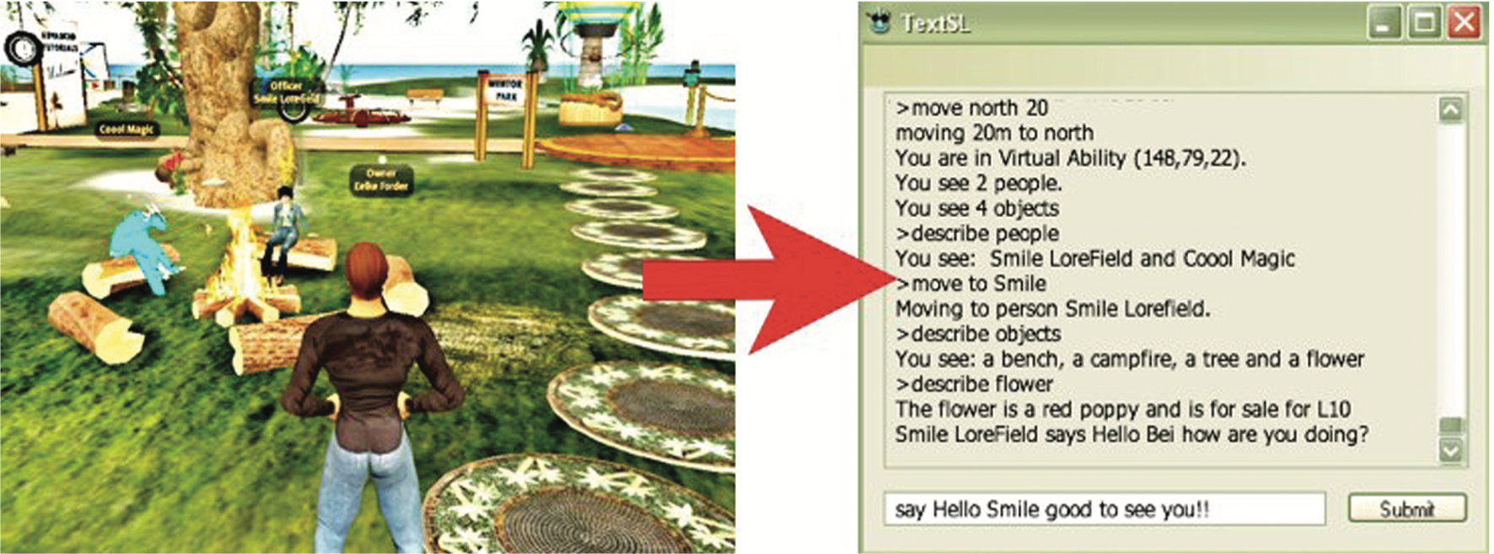
Second Life command line-based interface for visually-impaired users

Slide 6
Research and design considerations
Form, name types and structure are key research questions
Consistency is most important design principle
For example, always use first letter of command
Command interfaces popular for web scripting
Notes:
6

Slide 7
Graphical user interfaces (GUIs)
Xerox Star first WIMP gave rise to GUIs
Windows
Sections of the screen that can be scrolled, stretched, overlapped, opened, closed, and moved around the screen using the mouse
Icons
Pictograms that represent applications, objects, commands, and tools that were opened when clicked on
Menus
Lists of options that can be scrolled through and selected
Pointing device
A mouse controlling the cursor as a point of entry to the windows, menus, and icons on the screen
Notes:
7

Slide 8
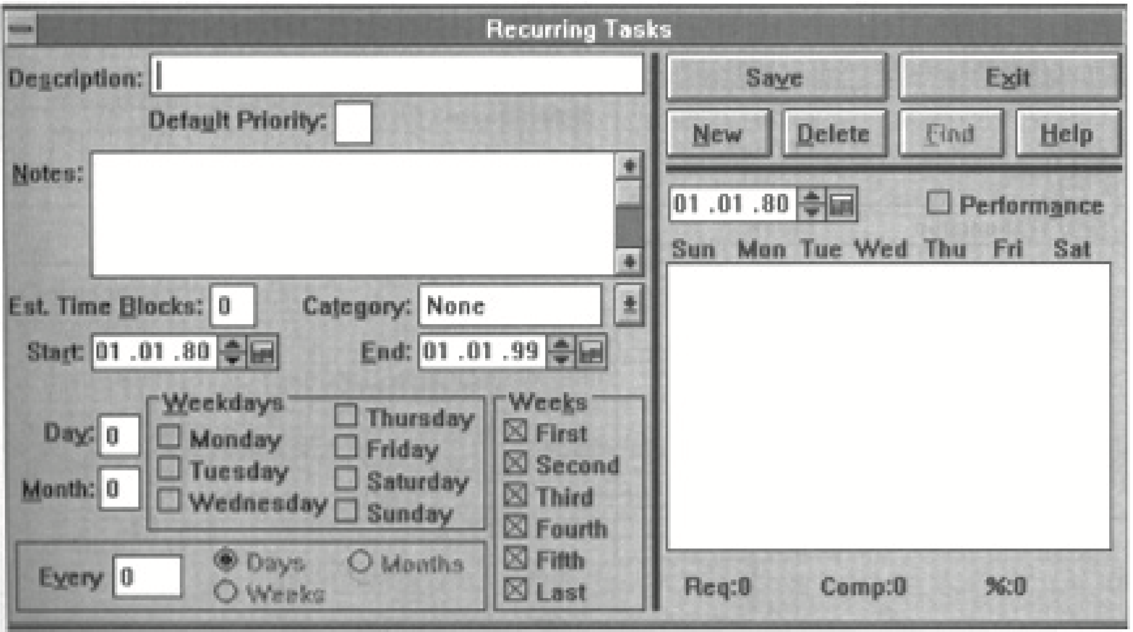
Example of first generation GUI
Notes:
8

Slide 9
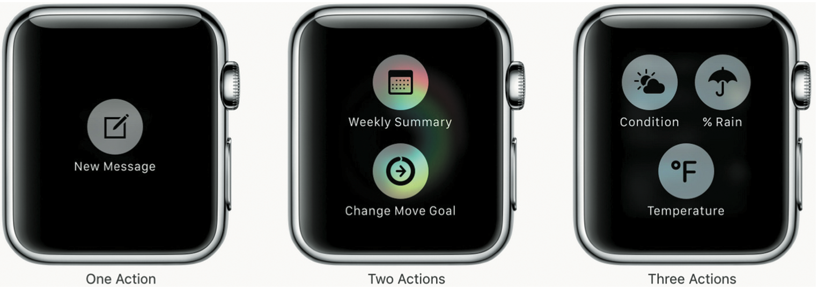
Simple smartwatch menus with 1, 2, or 3 options

Slide 10
Window design
Windows were invented to overcome the physical constraints of a computer display
They enable more information to be viewed and tasks to be performed
Scroll bars within windows enable more information to be viewed
Multiple windows can make it difficult to find desired one
Listing, tabbing, and thumbnails are techniques that can help
Notes:
10

Slide 11
Window design: Thumbnails of top websites visited and suggested highlights

Slide 12

Selecting a country from a scrolling window
Notes:
12

Slide 13
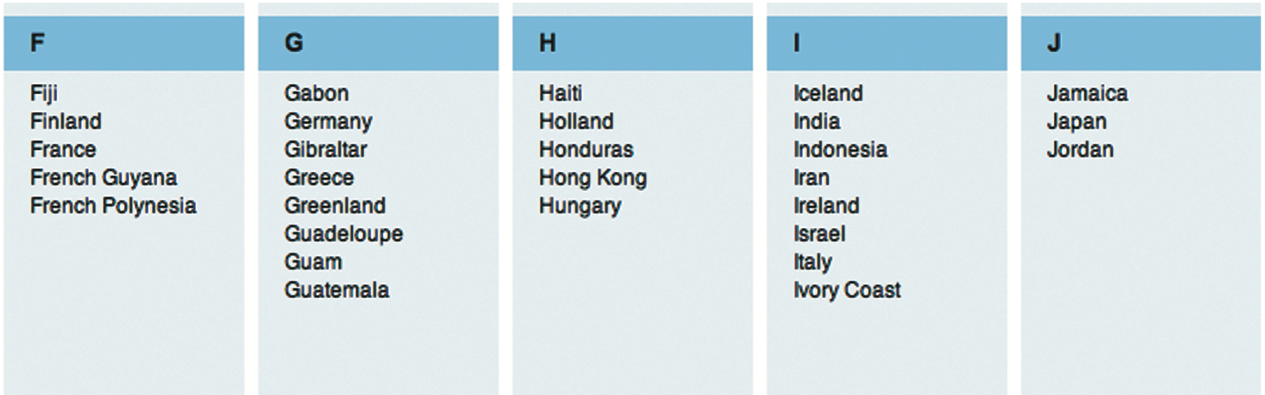
Is this method any better?
Notes:
13

Slide 14
Menu styles
Flat list: Good for showing large number of options at the same time when display is small
Drop down: Shows more options on same screen (for example, cascading)
Pop-up: When pressed, command key for relevant options
Contextual: Provides access to often-used commands associated with a particular item
Collapsible: Toggles between + and − icons on a header to expand or contract its contents
Mega: All options shown using 2D drop-down layout

Slide 15
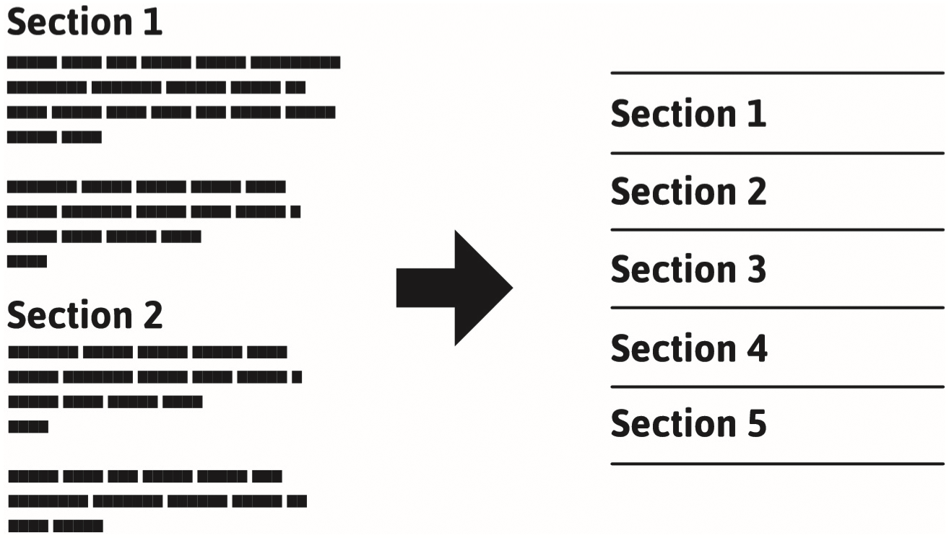
Template for a collapsible menu

Slide 16
A mega menu

Slide 17
Research and design considerations
Window management
Enables users to move fluidly between different windows (and monitors)
How to switch attention between windows without getting distracted
Design principles of spacing, grouping, and simplicity should be used
Which terms to use for menu options (for example, “front” versus “bring to front”
Mega menus easier to navigate than drop-down ones
Notes:
17

Slide 18
Icon design
Icons are assumed to be easier to learn and remember than commands
Icons can be designed to be compact and variably positioned on a screen
Now pervasive in every interface
For example, they represent desktop objects, tools (for example, a paintbrush), applications (for instance, a web browser), and operations (such as cut, paste, next, accept, and change)
Notes:
18

Slide 19
Icons
Since the Xerox Star days, icons have changed in their look and feel:
black and white
Color, shadowing, photorealistic images, 3D rendering, and animation
Many designed to be very detailed and animated making them both visually attractive and informative
Can be highly inviting, emotionally appealing, and feel alive
Notes:
19

Slide 20
Icon forms
The mapping between the representation and underlying referent can be:
Similar (for example, a picture of a file to represent the object file)
Analogical (for instance, a picture of a pair of scissors to represent ‘cut’)
Arbitrary (such as the use of an X to represent ‘delete’)
The most effective icons are similar ones
Many operations are actions making it more difficult to represent them
Use a combination of objects and symbols that capture the salient part of an action
Notes:
20

Slide 21
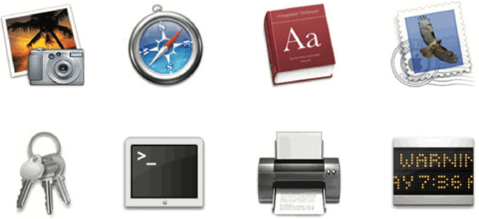
2 types of icon styles
Notes:
21

Slide 22
Flat 2D icons for a smartphone and a smartwatch
Notes:
22

Slide 23
Activity
Sketch simple icons to represent the following operations to appear on a digital camera screen:
Turn image 90-degrees sideways
Auto-enhance the image
Crop the image
More options
Show them to someone else and see if they can understand what each represents
Notes:
23

Slide 24

Basic edit icons that appear on the iPhone app

Slide 25
Research and design considerations
There is a wealth of resources for creating icons
Guidelines, style guides, icon builders, libraries, online tutorials
Text labels can be used alongside icons to help identification for small icon sets
For large icon sets (for instance, photo editing or word processing) can use the hover function
Notes:
25

Slide 26
Multimedia
Combines different media within a single interface with various forms of interactivity
Graphics, text, video, sound, and animation
Users click on links in an image or text
Another part of the program
An animation or a video clip is played
Users can return to where they were or move on to another place
Can provide better ways of presenting information than a single media can
Notes:
26

Slide 27
Pros and cons
Facilitates rapid access to multiple representations of information
Can provide better ways of presenting information than can any media alone
Can enable easier learning, better understanding, more engagement, and more pleasure
Can encourage users to explore different parts of a game or story
Tendency to play video clips and animations while skimming through accompanying text or diagrams
Notes:
27

Slide 28
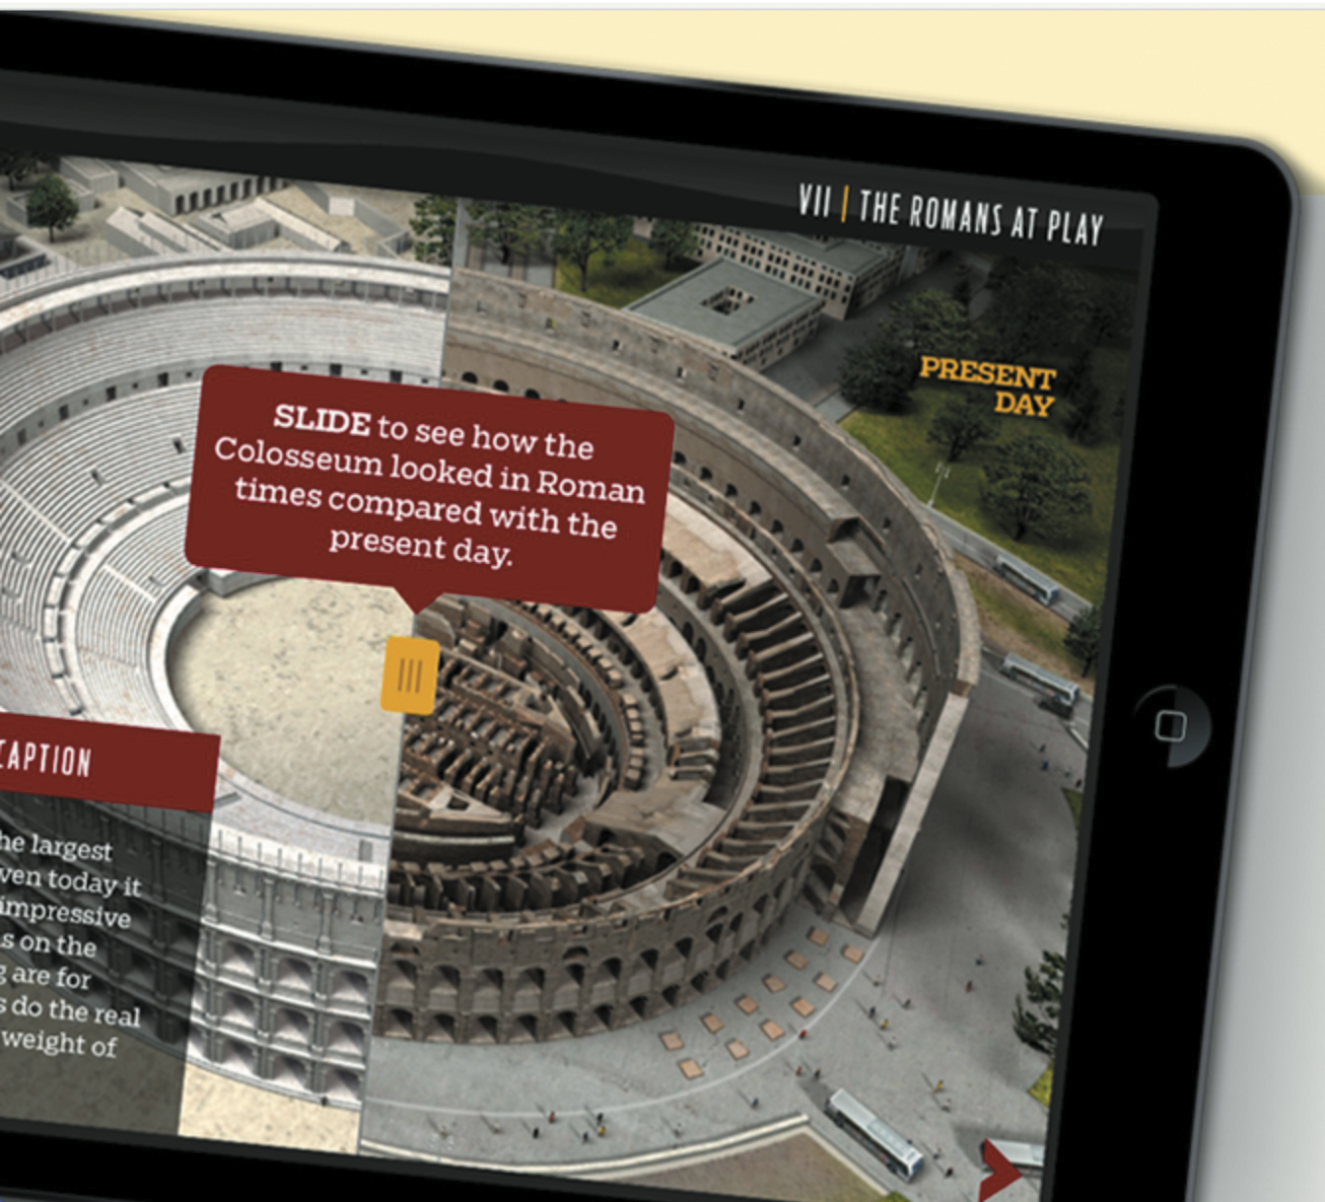
Multimedia learning app designed for tablet

Slide 29
Research and design considerations
How to design multimedia to help users explore, keep track of, and integrate the multiple representations
Provide hands-on interactivities and simulations that the user has to complete to solve a task
Provide quizzes, electronic notebooks, and games
Multimedia good for supporting certain activities, such as browsing, but less optimal for reading at length
Notes:
29

Slide 30
Virtual reality
Computer-generated graphical simulations providing:
“the illusion of participation in a synthetic environment rather than external observation of such an environment” (Gigante, 1993)
Provide new kinds of experience, enabling users to interact with objects and navigate in 3D space
Create highly-engaging user experiences
Notes:
30

Slide 31
Pros and cons
Can have a higher level of fidelity with objects that they represent compared to multimedia
Induces a sense of presence where someone is totally engrossed by the experience
“a state of consciousness, the (psychological) sense of being in the virtual environment” (Slater and Wilbur, 1999)
Provides different viewpoints: first and third person
Early head-mounted displays were uncomfortable to wear and could cause motion sickness and disorientation
Lighter VR headsets are now available (for example, HTC Vive) with more accurate head tracking
Notes:
31

Slide 32
Application areas
Video games
Arcade games for social groups
Therapy for fears
Experience how others feel emotions
For example, empathy and compassion
Enrich user’s planning experience for travel destinations
Architecture, design, and education

Slide 33
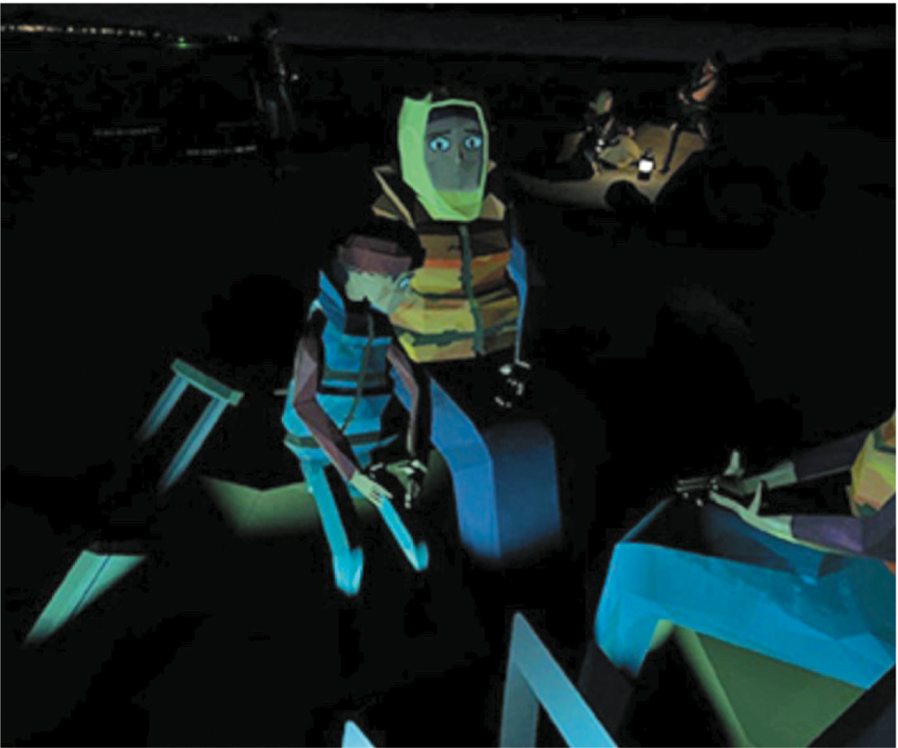
Polygon graphics used to represent avatars for the We Wait VR experience

Slide 34
Research and design considerations
Much research on how to design safe and realistic VRs to facilitate training
For example, flying simulators
Help people overcome phobias (for example, spiders or talking in public)
Design issues
How best to navigate through them (for instance, first versus third person)
How to control interactions and movements (for example, by using head and body movements)
How best to interact with information (for instance by using keypads, pointing, and joystick buttons)
Level of realism to aim for to engender a sense of presence
Notes:
34

Slide 35
Website design
Early websites were largely text-based, providing hyperlinks
Concern was with how best to structure information to enable users to navigate and access them easily and quickly
Nowadays, more emphasis is on making pages distinctive, striking, and aesthetically pleasing
Need to think of how to design information for multiple platforms—keyboard or touch?
For example, smartphones, tablets, and PCs
Notes:
35

Slide 36
Usability versus aesthetics?
Vanilla or multi-flavor design?
Ease of finding something versus aesthetic and enjoyable experience
Web designers are:
“thinking great literature”
Users read the web like a:
“billboard going by at 60 miles an hour” (Krug, 2014)
Need to determine how to brand a web page to catch and keep ‘eyeballs’
Notes:
36

Slide 37
Breadcrumbs for navigation
Breadcrumbs are category labels:
Enable users to look at other pages without losing track of where they have come from
Very usable
Enable one-click access to higher site levels
Attract first time visitors to continue to browse a website having viewed the landing page

Slide 38
In your face Web ads
Web advertising is often intrusive and pervasive
Flashing, aggressive, persistent, and annoying
Often requires action to get rid of
What is the alternative?
Use of ad blockers
Notes:
Web advertising has become pervasive and invasive. Advertisers realized how effective flashing and animated ads were for promoting their products, taking inspiration from the animated neon light adverts used in city centers, such as London’s Piccadilly Circus. But since the banner ads (the 728 x 90 pixel ads that were placed at the top of web pages) emerged in the 90s, they have become even more cunning and aggressive in their tactics. In addition to designing even flashier banner ads, more intrusive kinds of web ads have begun to appear on our screens. Short movies and garish cartoon animations – often with sound – now pop up in floating windows that zoom into view or tagged on at the front end of a online newspaper or magazine news videoclip. Moreover, this new breed of in-your-face web ads often requires the user to either sit and wait till it ends or find a checkbox to close the window down. This can be really annoying to have to do especially when multiple ad windows open up. Sites that provide free services, such as Facebook, YouTube and Gmail, have also become populated with web ads. Many people choose to ignore them or simply put up with them. However, as advertisers get even more aggressive in their tactics there will be a point where that will become harder to do. The problem is advertisers pay significant revenues to online companies to have their adverts placed on their websites entitling them to say where, what and how they should appear
38

Slide 39
Research and design considerations
Many books and guidelines on website design
Veen’s (2001) three core questions to consider when designing any website:
Where am I?
Where can I go?
What’s here?
Notes:
39

Slide 40
Activity
Look at a fashion brand’s website, for example, Nike.com
What kind of website is it?
How does it contravene the design principles outlined by Veen?
Does it matter?
What kind of user experience is it providing for?
What was your experience of engaging with it?
Notes:
40

Slide 41
Mobile interfaces
Handheld devices intended to be used while on the move
Have become pervasive, increasingly used in all aspects of everyday and working life
For example, phones, fitness trackers, and smartwatches
Larger-sized tablets used in mobile settings
Including those used by flight attendants, marketing professionals, and at car rental returns
Notes:
41

Slide 42
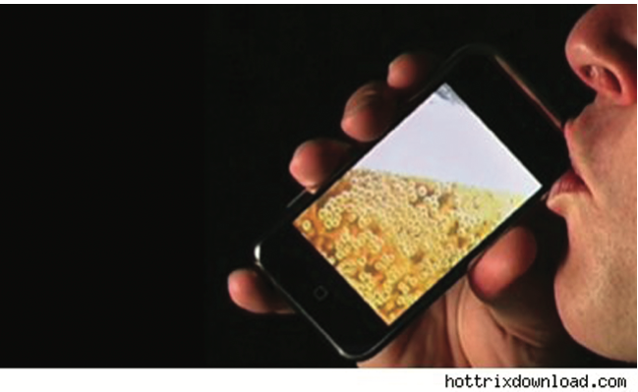
iBeer app

Slide 43
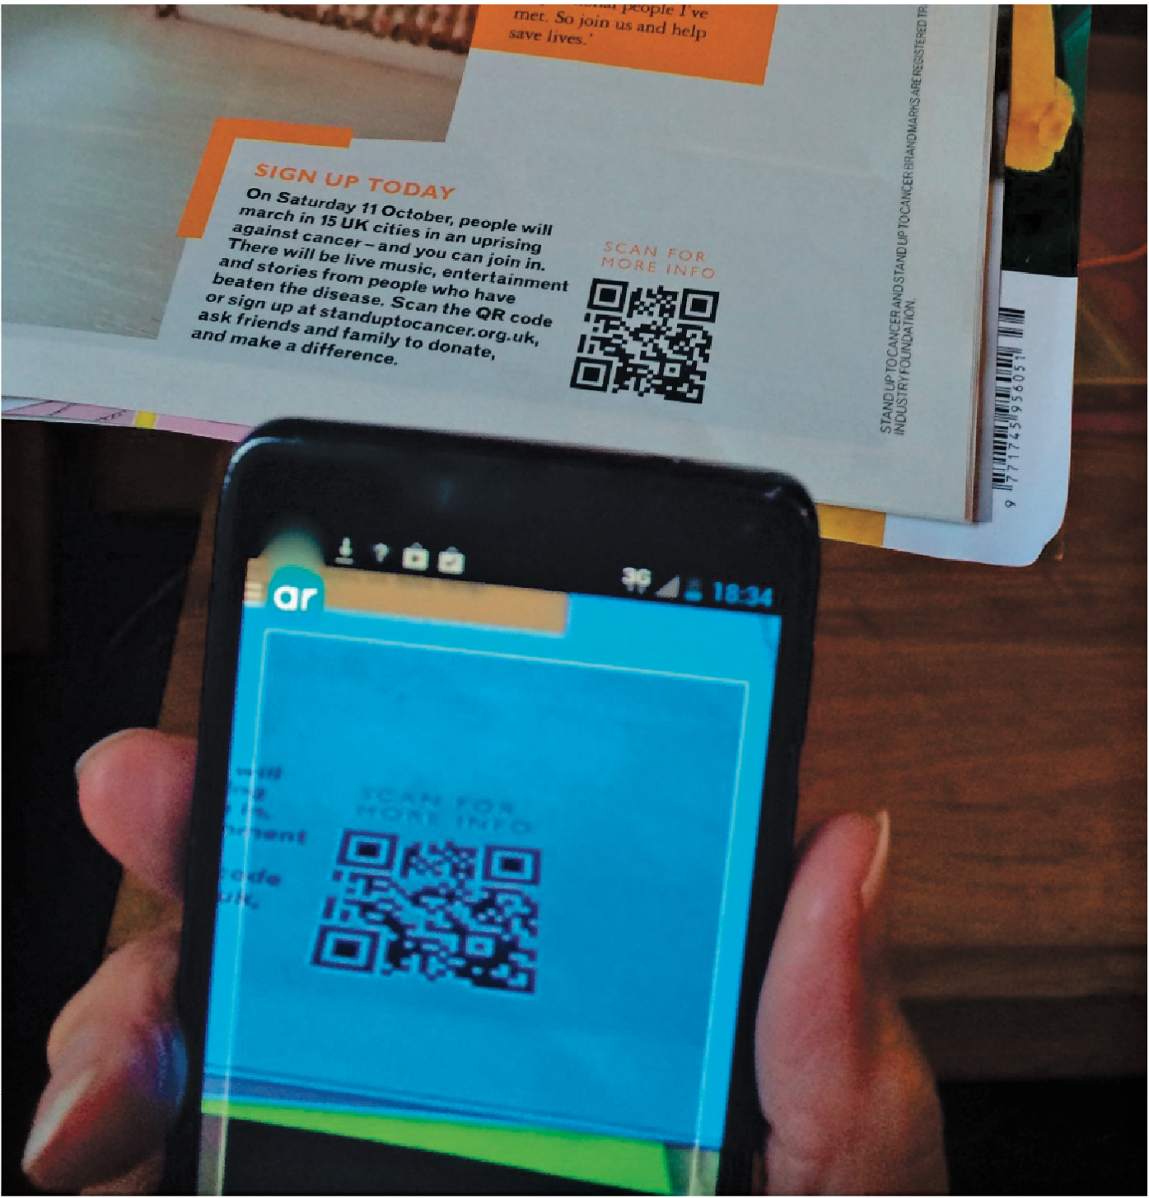
QR codes and smartphones

Slide 44
Research and design considerations
Mobile interfaces can be cumbersome to use for those with poor manual dexterity or ‘fat’ fingers
Key concern is hit area:
Area on the phone display that the user touches to make something happen, such as a key, an icon, a button, or an app
Space needs to be big enough for all fingers to press accurately
If too small, the user may accidentally press the wrong key
Fitts’ law can be used to help design right spacing
Minimum tappable areas should be 44 points x 44 points for all controls
Notes:
44
Mobile interfaces typically have a small screen and limited control space. Designers have to think carefully about what type of dedicated controls (i.e. hard wired) to use, where to place them on the device, and then how to map them onto the software. Applications designed for mobile interfaces need to take into account that navigation will be restricted and text input entry slow, whether using touch, pen or keypad input. The use of vertical and horizontal scrolling provides a rapid way of scanning though images, menus and lists. A number of mobile browsers have also been developed that allow users to view and navigate the internet, magazines or other media, in a more streamlined way compared with how it is typically viewed via PC-based web browsers. For example, Edge Browser was one the first mobile phone browser apps to not have an address bar or navigation buttons. The trade-off, however, is it makes it less obvious how to perform the functions that are no longer visible on the screen.

Slide 45
Appliances
Everyday devices in home, public places, or car
For example, washing machines, remotes, toasters, printers, and navigation systems)
And personal devices
For instance, digital clock and digital camera
Used for short periods
For example, starting the washing machine, watching a program, buying a ticket, changing the time, or taking a snapshot
Need to be usable with minimal, if any, learning

Slide 46
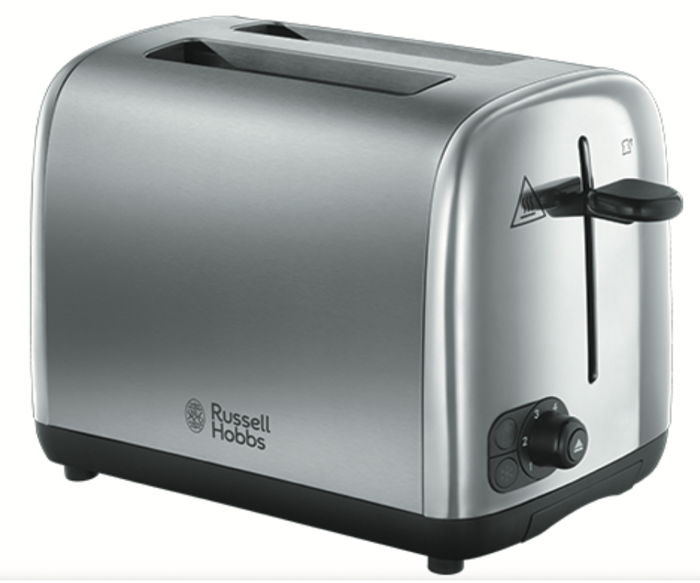
Simple toaster control

Slide 47
Research and design considerations
Need to design as transient interfaces with short interactions
Simple interfaces
Consider trade-off between soft and hard controls
For example, use of buttons or keys, dials, or scrolling
Notes:
47

